Slide 1

Urban MODS 2019 GIS Workshop
Natalie Schultz, PhD
Associate Research Scientist
Forestry & Environmental Studies
Yale Center for Earth Observation
TC
PhD Candidate
Forestry & Environmental Studies

Slide 2

Roadmap
Introduction to GIS
Geospatial data types & coordinate systems
Applications for environmental questions
Case Study
Drivers of high urban temperatures, strategies for heat mitigation
Disparate impacts on different demographic groups
Hands-on Activity
Explore the relationship between street trees and mobile meteorological measurements
Use satellite data to scale up analysis to the entire city
Wrap-up
Discussion of activity results
Review of geospatial resources @ Yale
Questions?
Examine spatial patterns between environmental quality & socioeconomic data
Delineate the Beaver Ponds sewershed and watershed

Slide 3
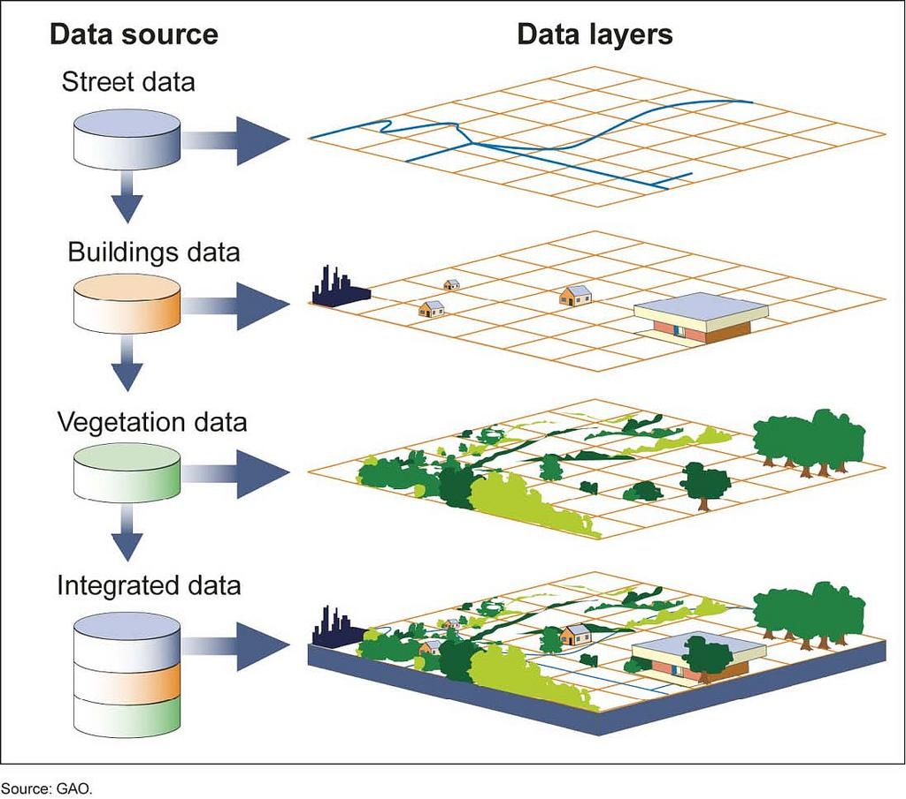
Geographic Information Systems
A system for capturing, storing, checking, integrating, manipulating, analyzing and displaying data which are spatially referenced to the Earth.
(Chorley, 1987)

Slide 4
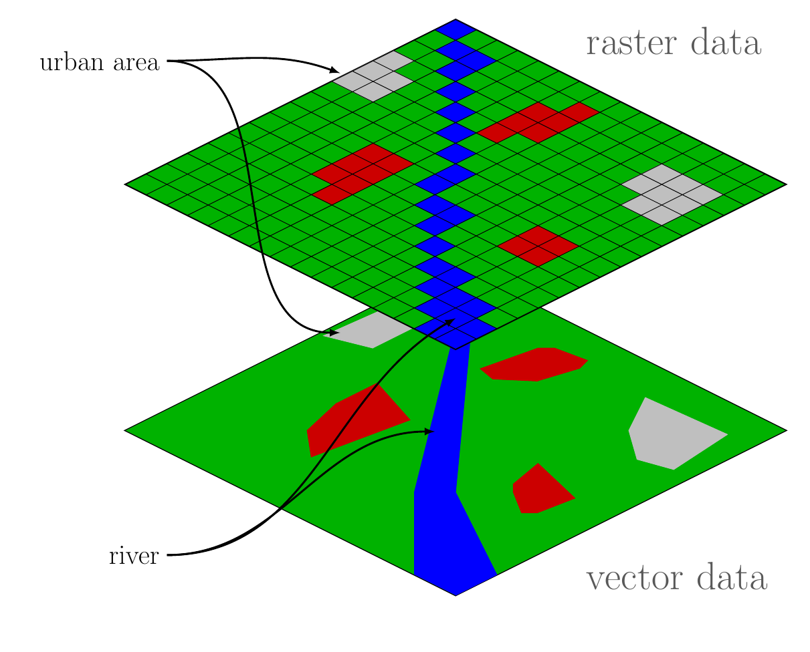
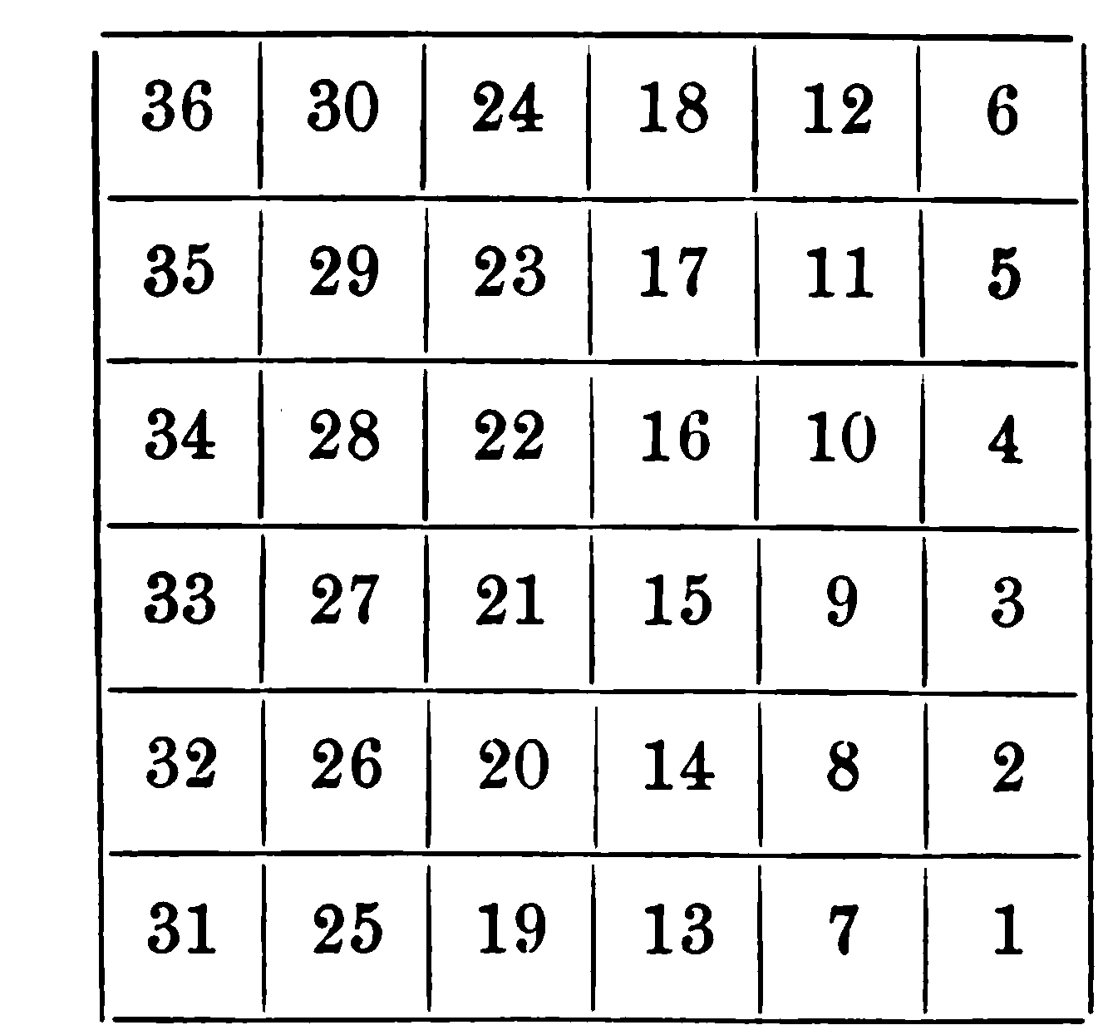
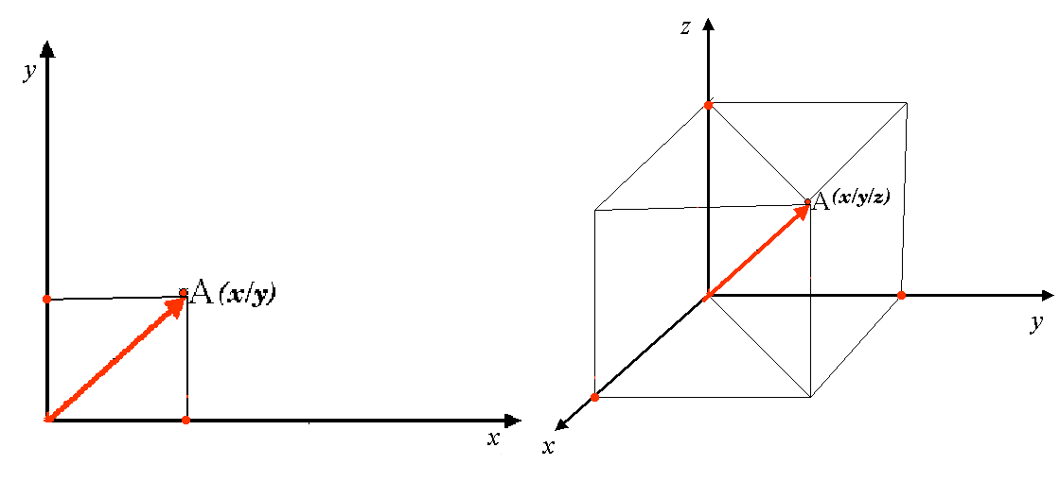
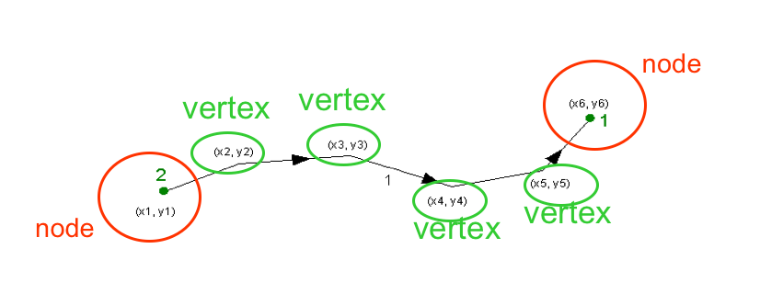
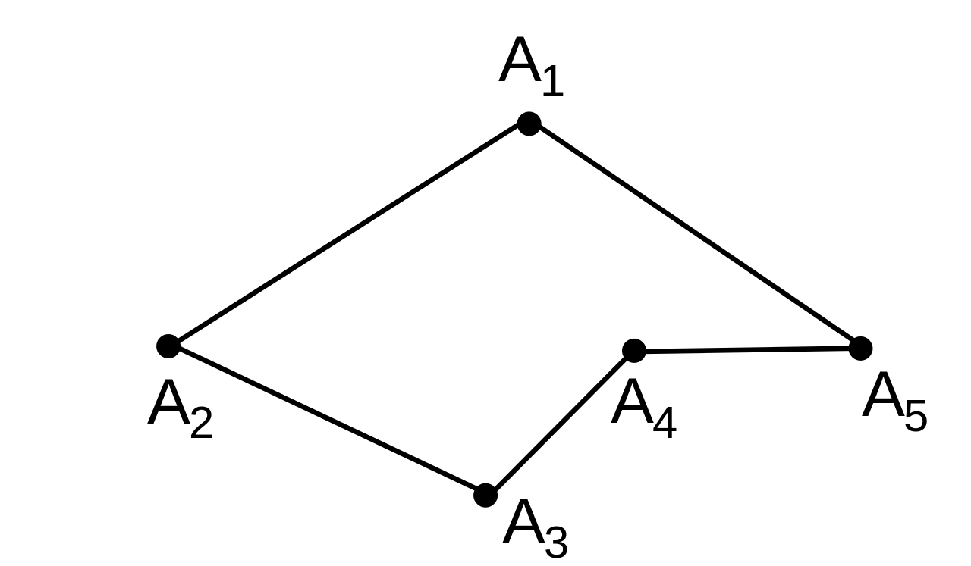
Types of Spatial Data
Vector
Points
Lines
Polygons
Raster
Notes:
Note, this slide is animated.
Point - a single coordinate-pair
Wells, weather stations, stream gauges
Line - two end nodes and zero or more vertices
Streams, roads, wind direction vector
Polygon - closed line with the same beginning and ending node
Political boundaries - country, state, town Natural boundaries - watersheds

Slide 5
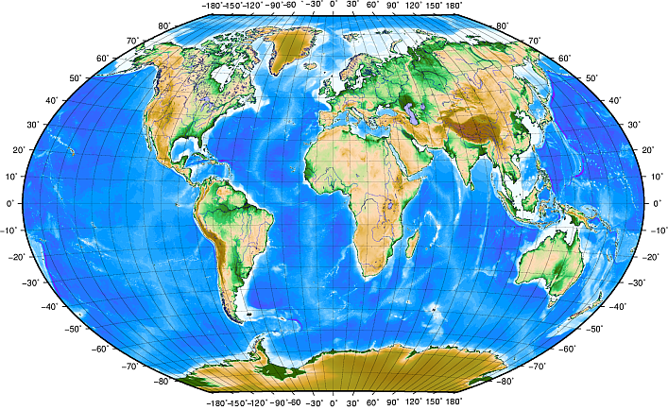
Coordinate Reference Systems
Provide a measurement system for geographic objects
Facilitates the measurement of
Distance
Area
Angles
Geographic Coordinate Reference Systems
Projected Coordinate Reference Systems
3D
2D
Units
decimal degrees (and minutes and seconds)
Example
World Geodetic System 1984 (WGS 84)
Units
meters, feet etc.
Example
Universal Transverse Mercator (UTM)
US State Plane Coordinate System
Notes:
In general CRS can be divided into projected coordinate reference systems (also called Cartesian or rectangular coordinate reference systems) and geographic coordinate reference systems.
Source: https://docs.qgis.org/2.8/en/docs/gentle_gis_introduction/coordinate_reference_systems.html#figure-plate-caree-projection
A geographic coordinate system uses a three-dimensional spherical surface to define locations on the earth. It includes an angular unit of measure, a prime meridian, and a datum (based on a spheroid). In a geographic coordinate system, a point is referenced by its longitude and latitude values. Longitude and latitude are angles measured from the earth's center to a point on the earth's surface. The angles often are measured in degrees (or in grads). Source: http://desktop.arcgis.com/en/arcmap/10.3/guide-books/map-projections/projection-basics-for-gis-professionals.htm
A projected coordinate system is defined on a flat, two-dimensional surface. Unlike a geographic coordinate system, a projected coordinate system has constant lengths, angles, and areas across the two dimensions. A projected coordinate system is always based on a geographic coordinate system that is based on a sphere or spheroid. In a projected coordinate system, locations are identified by x,y coordinates on a grid, with the origin at the center of the grid. Each position has two values that reference it to that central location. One specifies its horizontal position and the other its vertical position.
Source: http://desktop.arcgis.com/en/arcmap/10.3/guide-books/map-projections/projection-basics-for-gis-professionals.htm

Slide 6

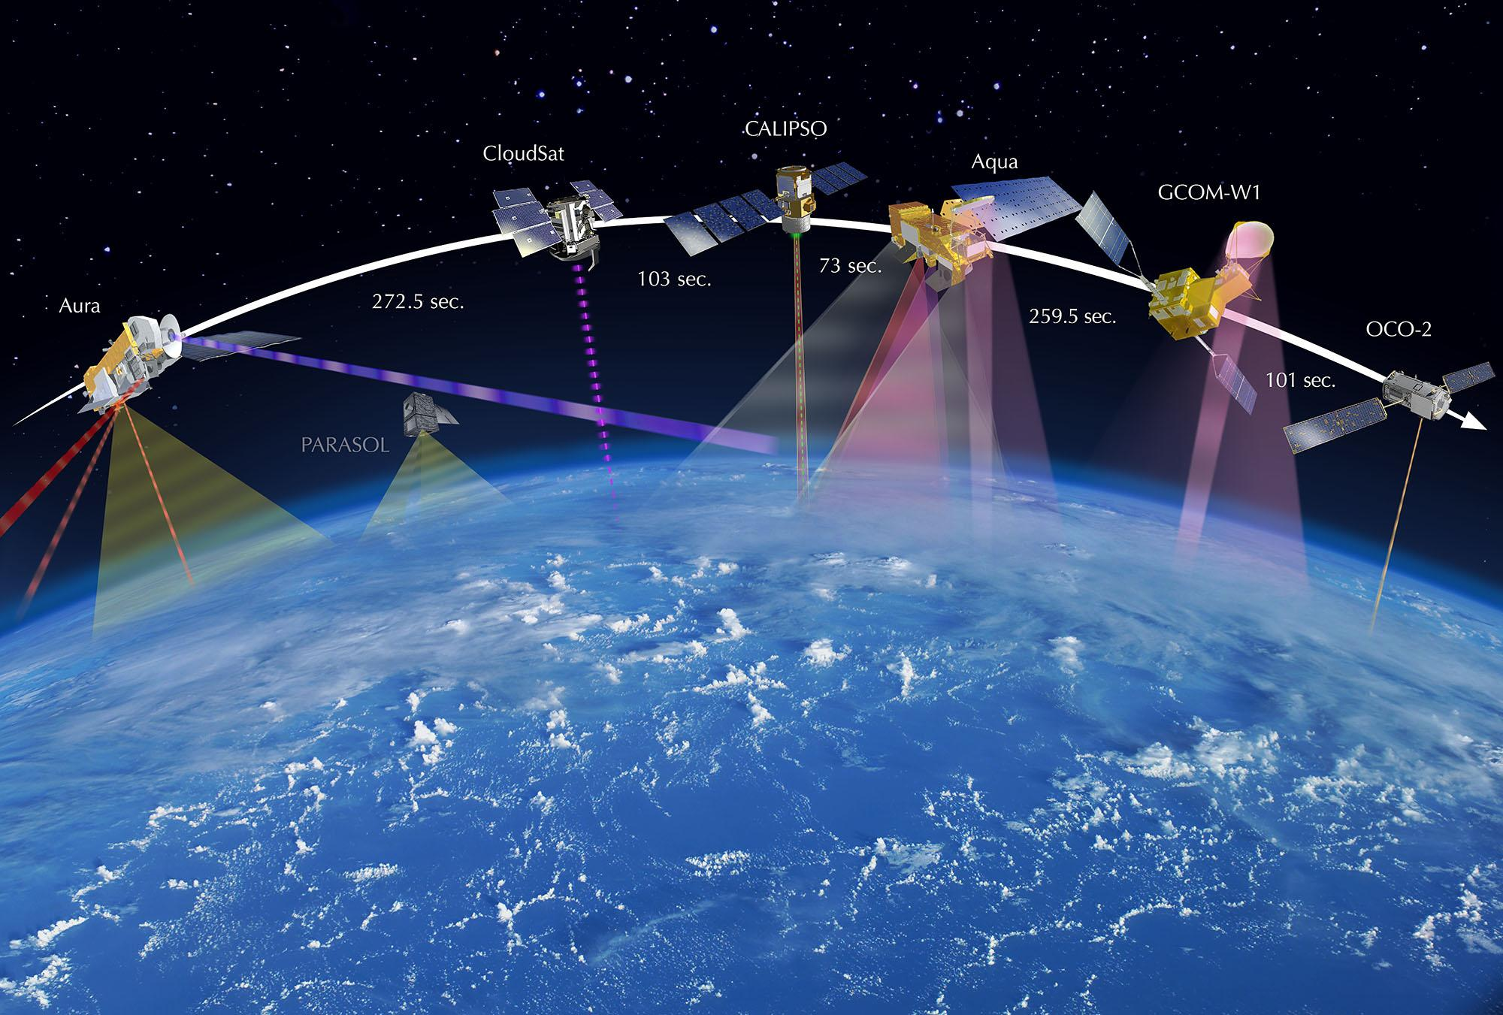
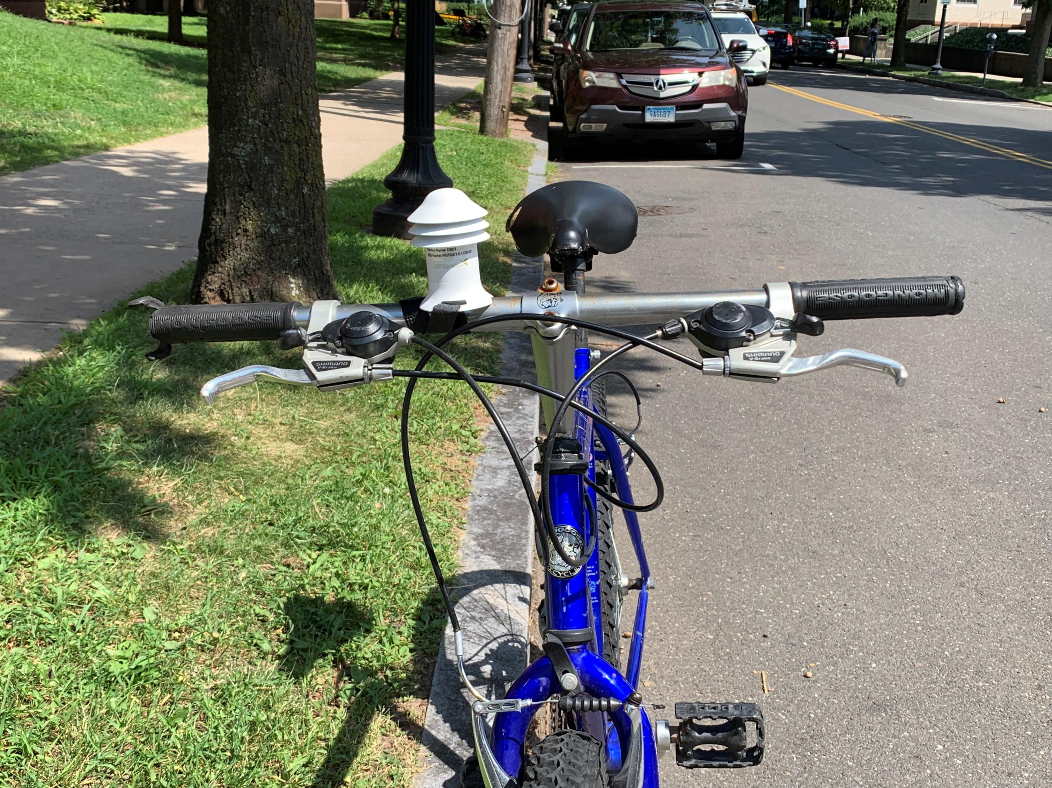
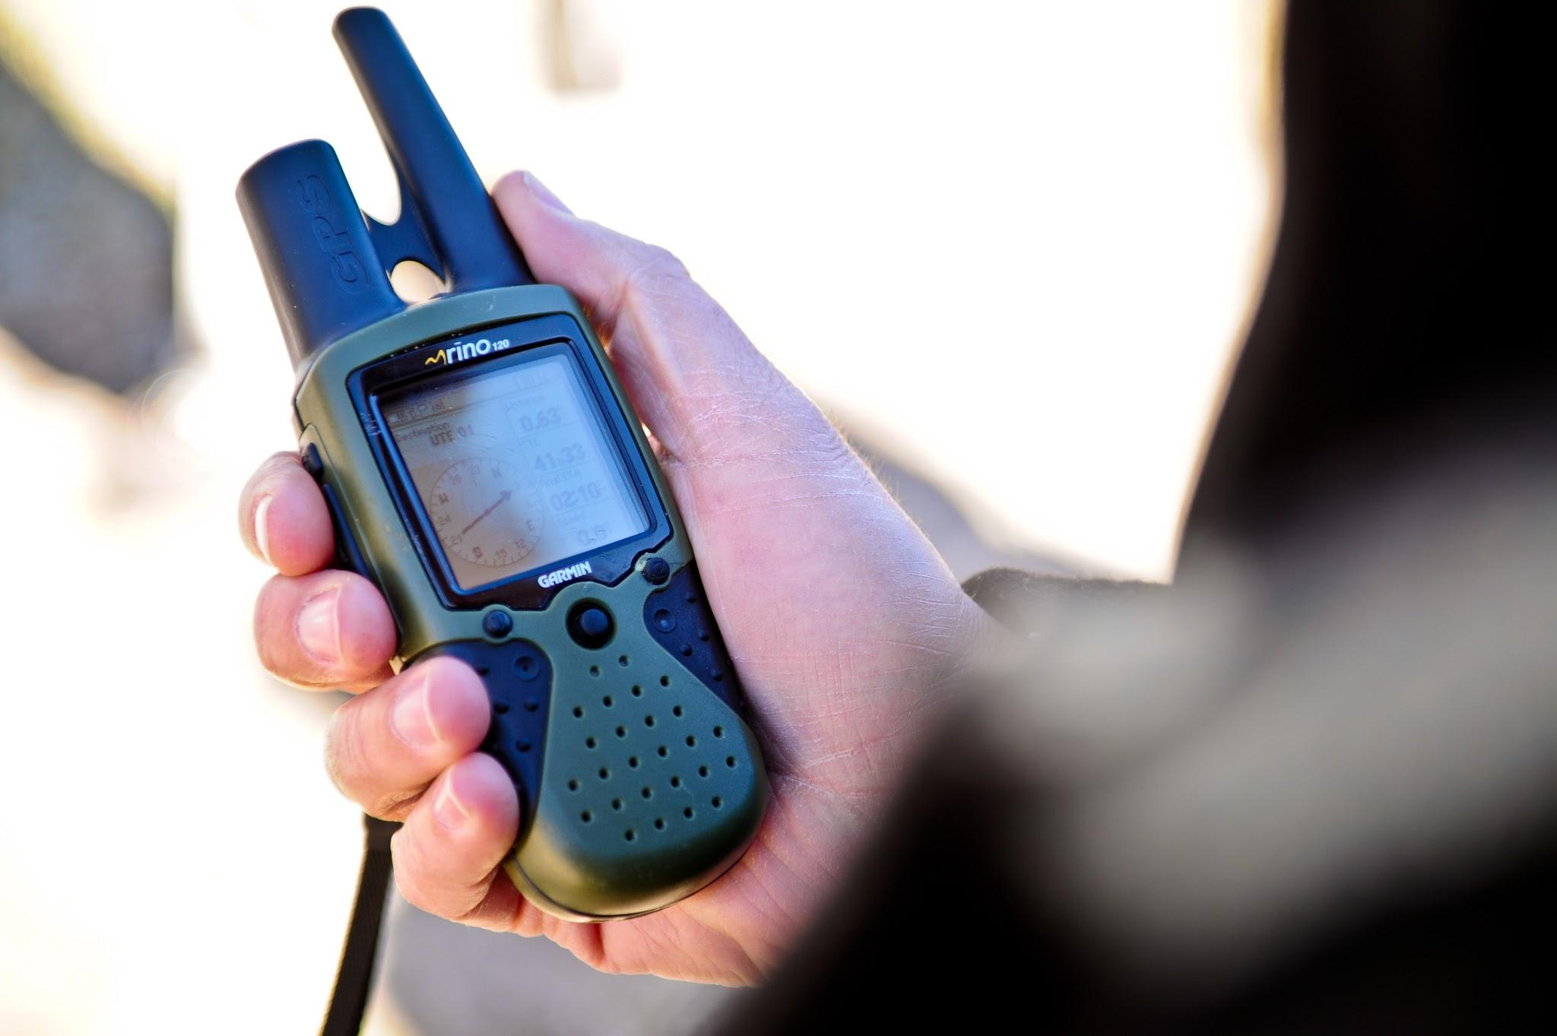
Capturing Data
Bird’s eye view
Satellites, planes, drones
Worm’s eye view
Field data

Slide 7
GIS Platforms & Software
Name | ArcGIS | QGIS | ENVI | R | Google Earth | Google Earth Engine
Uses | Mainly GIS Some Remote Sensing (RS) | Mainly GIS Some RS | RS | Mainly GIS Some RS | Some GIS Some RS | Some GIS Mainly RS
Open-source | No | Yes | No | Yes | No, Free to download | Yes
Interface | Graphical User Interface (GUI) Command Line | GUI Command Line | GUI | Command Line | GUI | Limited GUI Command Line
Local or Cloud | Local Some data streaming | Local Used for distributed computing too | Local | Local | Local Some data streaming | Cloud/ parallel computing

Slide 8
Case Study
Drivers of high urban temperatures, strategies for heat mitigation
Disparate impacts on different demographic groups

Slide 9
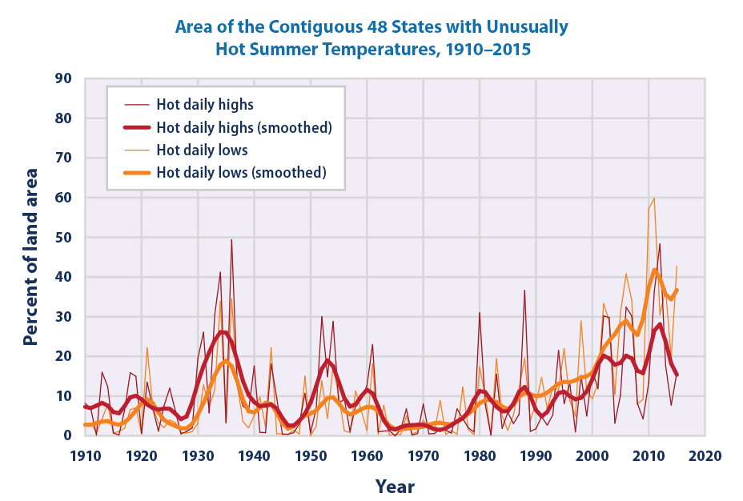
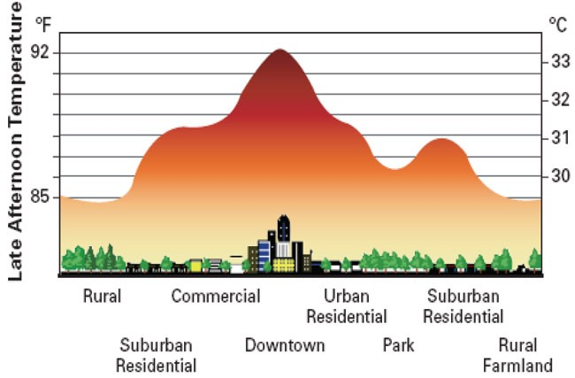
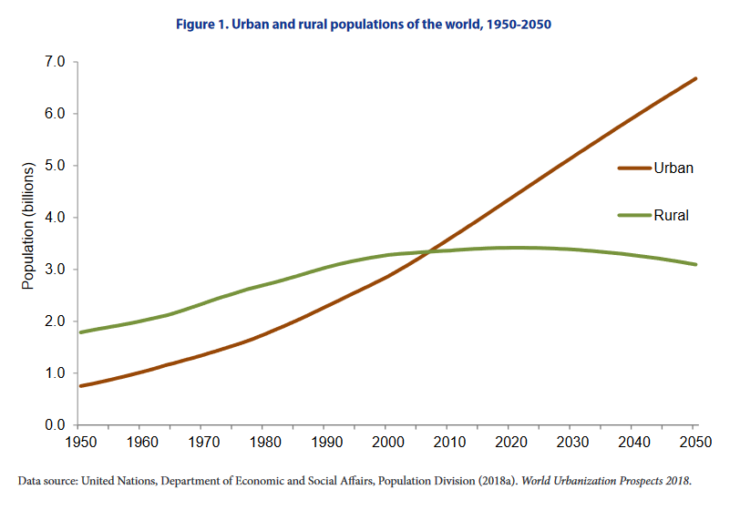
Urbanization & climate change
Climate change: higher temperatures + heatwaves
Source: NOAA
Urban heat island effect will increase already high temperatures
Image: EPA
Worldwide trend and projections of urban population growth
Source: UN
Notes:
https://www.epa.gov/heat-islands/climate-change-and-heat-islands
Climate change leads to higher temperatures and longer, more severe, and more frequent heat waves. Urban areas already suffering from the heat island effect will bear the brunt of these harsher heat events.
Fig: Percentage of the land area of the contiguous 48 states with unusually hot daily high and low temperatures during the months of June, July, and August, 1910-2015. Source: US EPA (2016)
--------------
Note causes of UHI: building materials/asphalt, less veg evaporative cooling, anthropogenic heat, etc…
--------------
68% of the world population projected to live in urban areas by 2050, says UN
16 May 2018, New York Today, 55% of the world’s population lives in urban areas, a proportion that is expected to increase to 68% by 2050. Projections show that urbanization, the gradual shift in residence of the human population from rural to urban areas, combined with the overall growth of the world’s population could add another 2.5 billion people to urban areas by 2050, with close to 90% of this increase taking place in Asia and Africa, according to a new United Nations data set launched today.
The 2018 Revision of World Urbanization Prospects produced by the Population Division of the UN Department of Economic and Social Affairs (UN DESA) notes that future increases in the size of the world’s urban population are expected to be highly concentrated in just a few countries. Together, India, China and Nigeria will account for 35% of the projected growth of the world’s urban population between 2018 and 2050. By 2050, it is projected that India will have added 416 million urban dwellers, China 255 million and Nigeria 189 million.
The urban population of the world has grown rapidly from 751 million in 1950 to 4.2 billion in 2018. Asia, despite its relatively lower level of urbanization, is home to 54% of the world’s urban population, followed by Europe and Africa with 13% each.
Today, the most urbanized regions include Northern America (with 82% of its population living in urban areas in 2018), Latin America and the Caribbean (81%), Europe (74%) and Oceania (68%). The level of urbanization in Asia is now approximating 50%. In contrast, Africa remains mostly rural, with 43% of its population living in urban areas.
https://www.un.org/development/desa/en/news/population/2018-revision-of-world-urbanization-prospects.html
https://population.un.org/wup/Publications/Files/WUP2018-Highlights.pdf

Slide 10
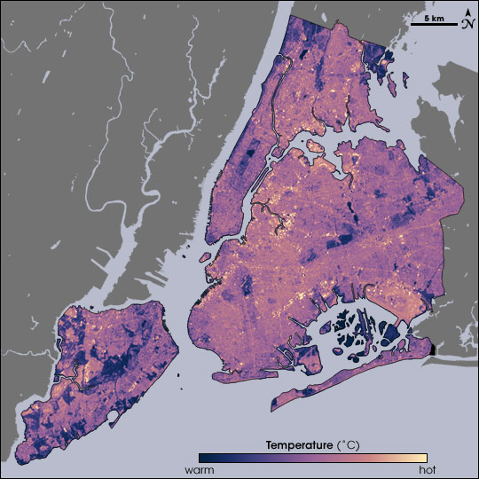
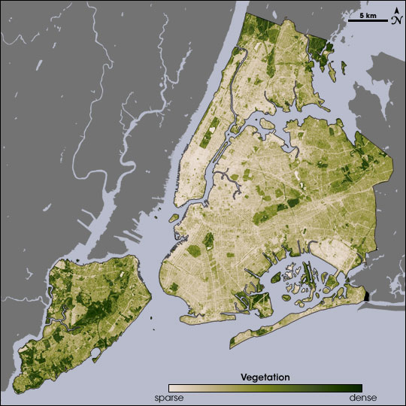
Urban heat mitigation strategies
Vegetation effective at reducing local temperatures
Tree planting
Green roofs
Cool roofs
Cool pavements
Source: NASA
Notes:
NYC LST and vegetation Aug 14 2002 (Landsat) during a heatwave
Note inverse relationship between temp & veg (high temp ~ low veg & vice versa)
Urban cooling can also reduce energy demands
https://earthobservatory.nasa.gov/features/GreenRoof/greenroof2.php
https://www.epa.gov/heat-islands/climate-change-and-heat-islands#c

Slide 11
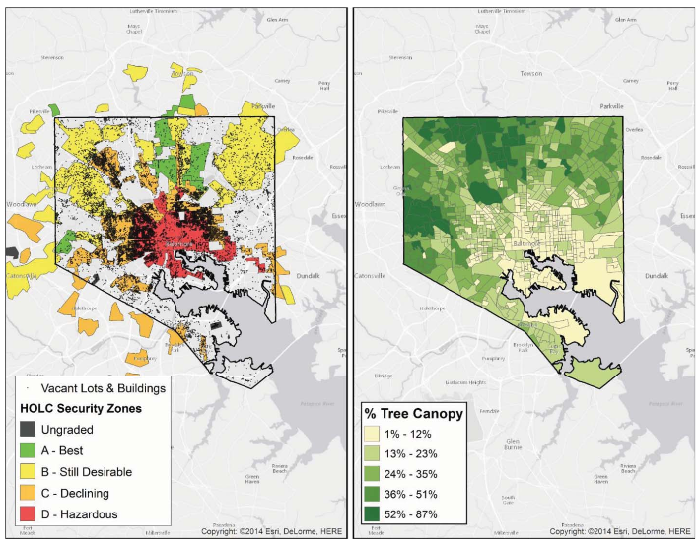
Urban environmental disparities
Legacy of “redlining” in Baltimore
Grove, M., et al. 2018
Annals of Am. Assoc. of Geographers
Notes:
From EPA:
Harmful Health Impacts
When people are exposed to extreme heat, they can suffer from potentially deadly illnesses, such as heat exhaustion and heat stroke. Older adults, young children, low-income populations, people who work outdoors, and people in poor health are the most vulnerable to these impacts. Many people die from extreme heat. Between 1979 and 2010, heat was recorded as the underlying or contributing cause of death for nearly 8,000 Americans, peaking in 2006, a year of widespread heat waves and the second-hottest year on record in the contiguous 48 states. ¹ The actual number of heat-related deaths may be much higher since the cause of death may not be reported as "heat-related" on death certificates.
https://www.epa.gov/heat-islands/climate-change-and-heat-islands#c
----------------------------------------------------------
https://www.fs.fed.us/nrs/pubs/jrnl/2017/nrs_2017_grove_001.pdf
From article (pg 528):
In 1937, the Federal Home Owners’ Loan Corporation (HOLC) was charged with refinancing homes in danger of foreclosure. The HOLC assigned a security grade to each neighborhood based on the perceived risk of default, using criteria that included occupation of residents, annual income, pre-dominant nationality, percentage of “negro families,” percentage of families on relief, and “threat of infiltration of foreign born, negro or lower grade population” (Grove et al. 2015, 138–39). The neighbor-hoods deemed at highest risk were labeled hazardous and mapped in red—hence the term “redlining” (Figure 3). The effect of these various policies, programs, laws, and practices has been to segregate African Americans into areas of West and East Baltimore and some sections of South Baltimore, institutionalizing a racially based legacy of disinvestment characterized by over-crowding, poor housing quality, encroachment of industrial uses, and noise from nearby businesses.
Pg 529:
The concentration of vacant lots and abandoned buildings and the absence of trees in neighborhoods reflect the HOLC’s redlining (Grove et al. 2015; Figure 5). The absence of trees produces collateral social and environmental disamenities, including higher levels of crime and higher temperatures and vulnerability to heat waves (Huang et al. 2011; Huang and Cadenasso 2016).

Slide 12
Activity
Explore the relationship between street trees and mobile meteorological measurements
Use satellite-derived products to investigate these patterns at the city-scale
Examine spatial patterns between environmental quality & socioeconomic data
Delineate the Beaver Ponds sewershed and watershed using geospatial tools

Slide 13
Data for this workshop
https://xxx.com/xxx
Download and then Save File
Go to your Downloads folder
Right-click UMODSweek3.zip and click Extract All. Next, click Extract.
Open the file MODS_GIS_2019.pdf.
Follow instructions for today’s workshop
Notes:
Describe water and snow sigs.
Why is the grass is green?
Show healthy veg sig
Comment on chlorophyll absorption
Red shoulder at NIR

Slide 14
ArcMap Demo
Accessing/extracting data
Opening ArcMap + loading first dataset
Basic tools

Slide 15
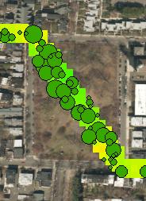
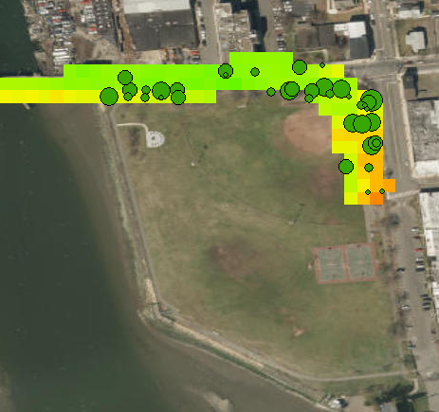
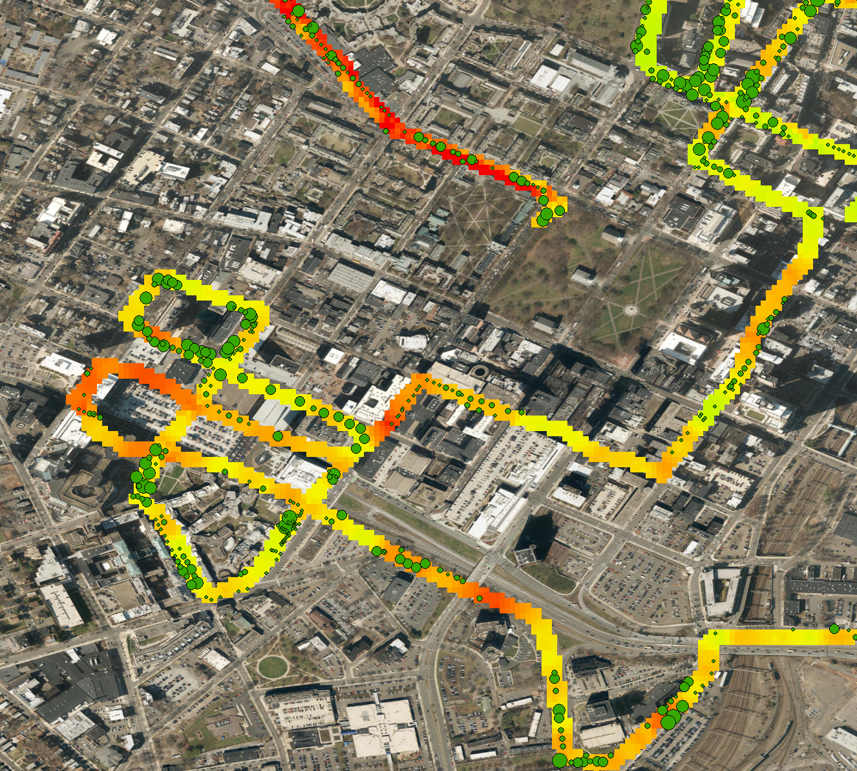
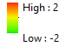
Discussion: Temperature & Tree Data
Bike temperature:
delta T = bike sensor – reference sensor
Parks
City Center

Slide 16
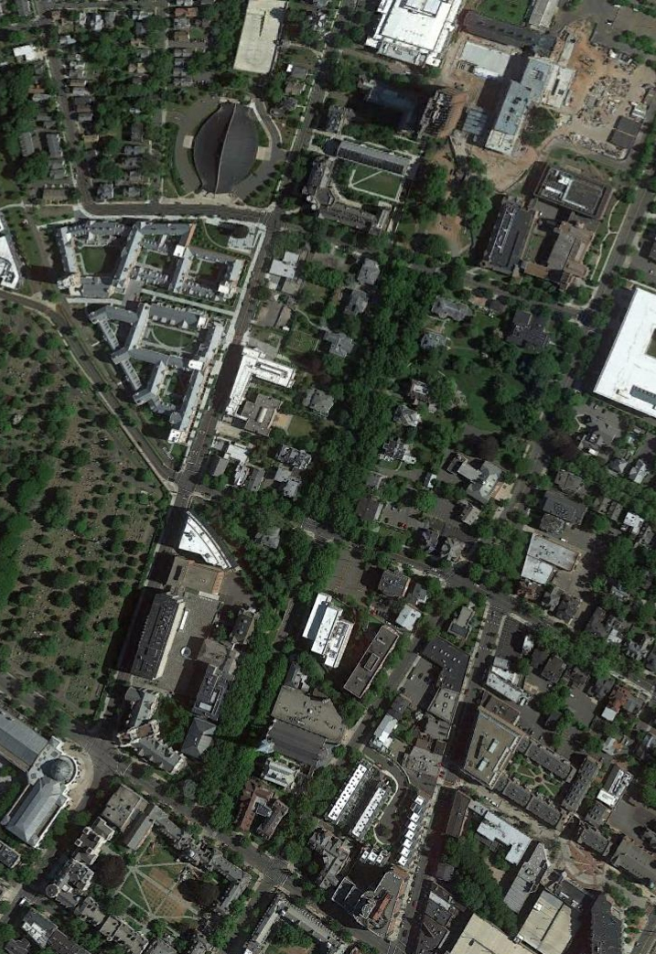
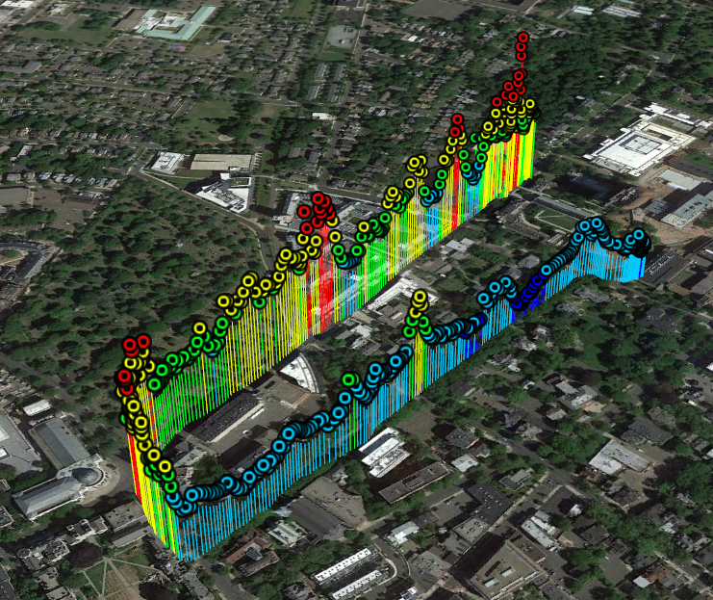
Discussion: Temperature & Tree Data
Prospect
Prospect
Hillhouse
Hillhouse

Slide 17
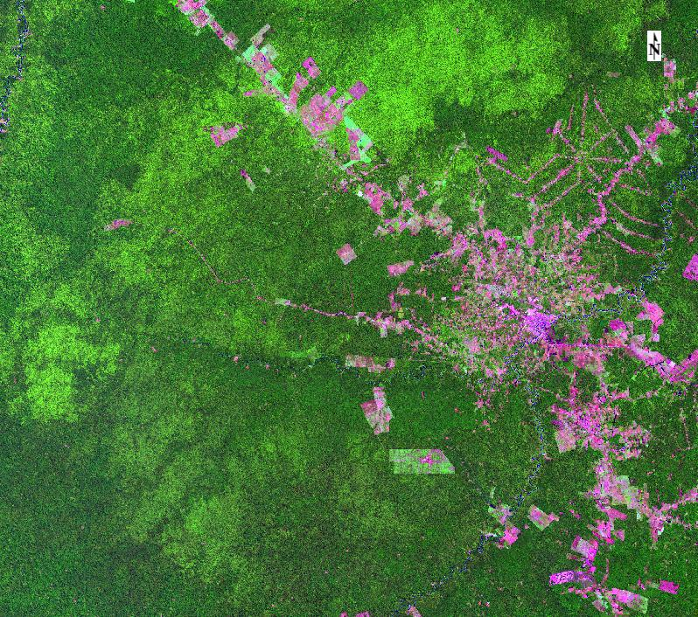
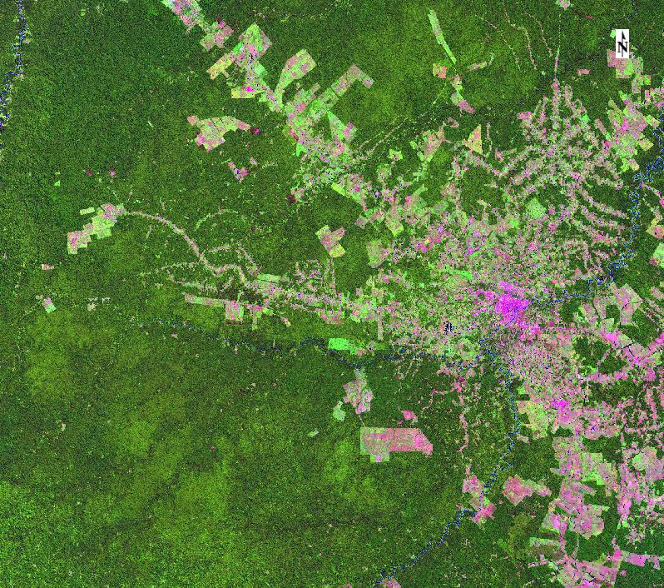
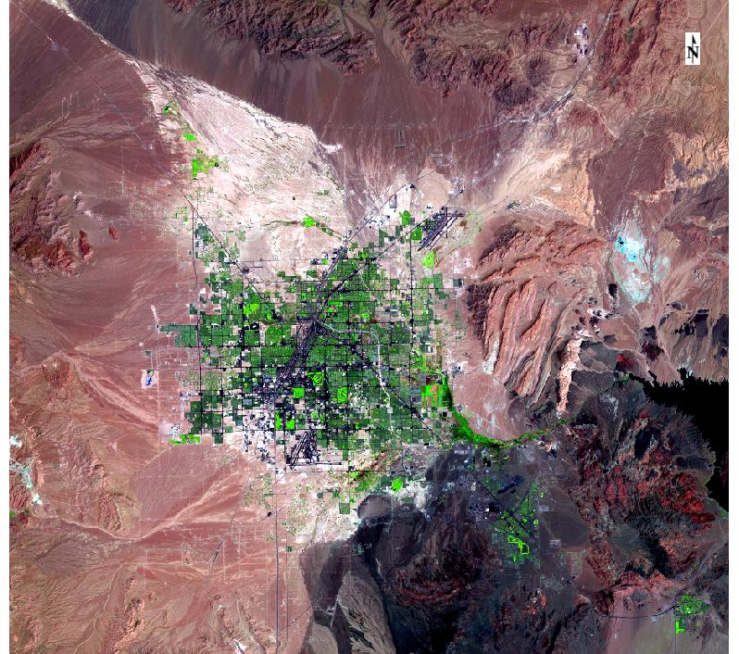
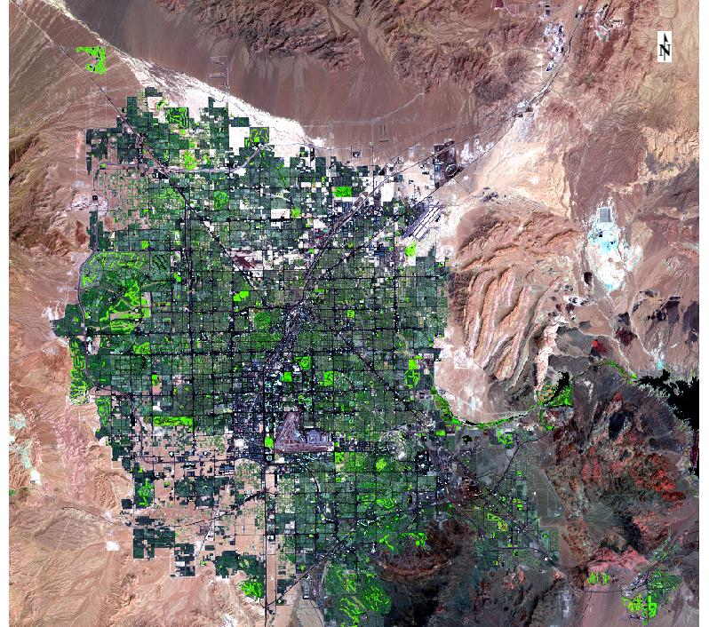
Remote Sensing/Earth Observation
Deforestation in Brazil
Earth observation (EO) is the gathering of information about planet Earth's physical, chemical and biological systems via remote sensing technologies supplemented by earth surveying techniques, encompassing the collection, analysis and presentation of data.
- [International Journal of Applied Earth Observation
and Geoinformation]
Remote sensing - sensors do not come into contact with the object being sensed
1988
1999
Urban Expansion in Las Vegas, Nevada
1985
2011

Slide 18
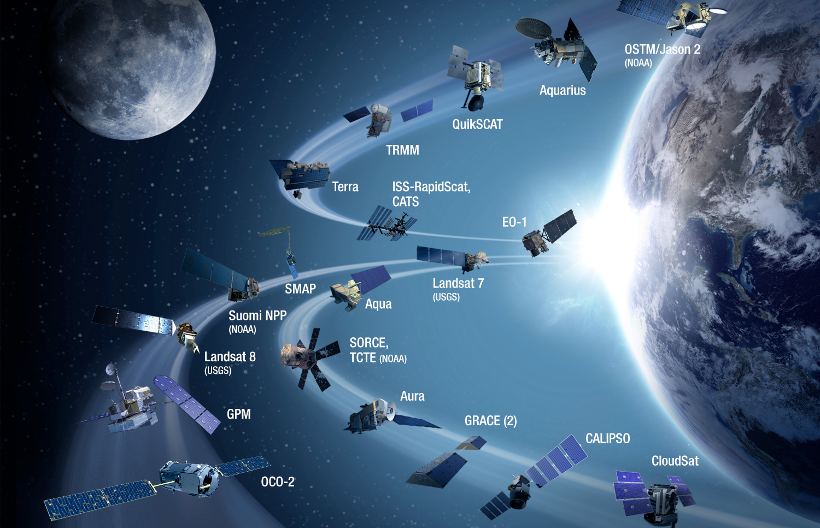
NASA Earth Observing System Data and Information System (EOSDIS)
6.4 TB of data per day
Source: NASA
Notes:
“Managing NASA Earth observing data is the responsibility of the Earth Observing System Data and Information System (EOSDIS), which provides end-to-end capabilities for managing NASA’s Earth science data. According to EOSDIS metrics for 2014, EOSDIS manages more than 9 petabytes (PB) of data. To put this into perspective, 1 PB is equivalent to about 20 million four-drawer filing cabinets filled with text. Even when you go to the next lower order of magnitude of data, the terabyte (TB), you still are talking about a lot of data - 10 TB can hold the entire printed collection of the Library of Congress. EOSDIS adds about 6.4 TB of data to its archives and distributes almost 28 TB worth of data to an average of 11,000 unique users around the world every day.” (https://earthdata.nasa.gov/getting-petabytes-to-people-how-the-eosdis-facilitates-earth-observing-data-discovery-and-use)

Slide 19
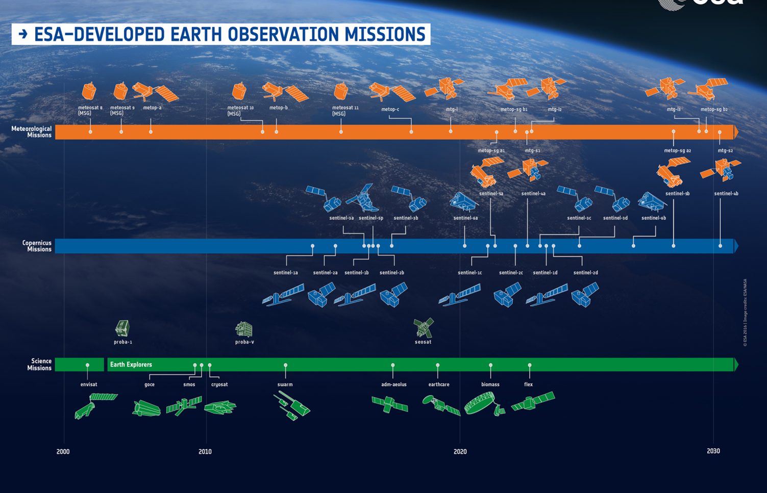
Copernicus (Sentinel)
150 TB of data per day
Source: ESA
Notes:
“Copernicus programme, the largest single Earth Observation program to date is delivering an unprecedented wealth of data imagery. In fact, during the ESA Earth Observation Φ-week, the director of ESA Earth Observation programmes Josef Aschabacher, announced that Sentinel missions are delivering 150 TB of satellite data per day! Cloud computing platforms and Artificial Intelligence (AI) are overtaking traditional tools to tackle challenges coming from Big Data and extraction of meaningful information taking advantage of high revisit time provided by these missions.” (http://blogs.esa.int/philab/2019/01/18/big-data-fusion/)

Slide 20
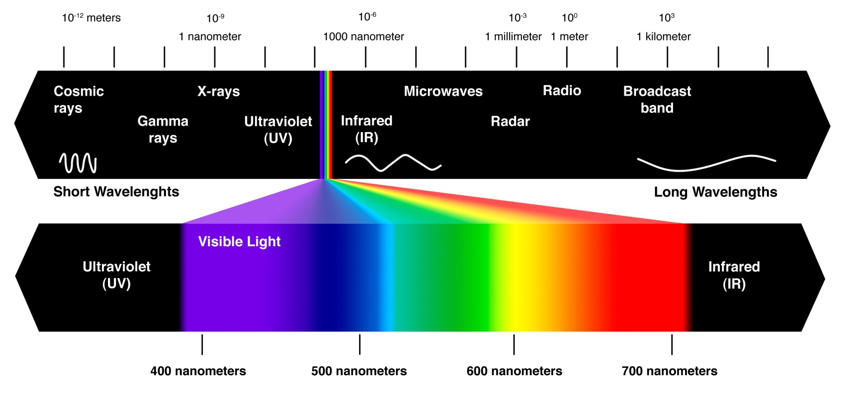
The Electromagnetic Spectrum
Notes:
The electromagnetic spectrum is the range of all types of electromagnetic radiation. The light that comes out of a lamp and the radio waves that come from a radio station are two types of electromagnetic radiation. Most satellites use passive sensors that measure reflected solar energy (400 – 2500 nanometers) which gives us information about the color and characteristics of the surface. They may also measure emitted longwave radiation, which we can use to calculate the temperature of earth’s surface.
Typically use passive sensors that reflect solar energy.
This is distributed across the EMS, but is greatest in the visible bands
This reflected energy is what we see and measure in satellite images

Slide 21
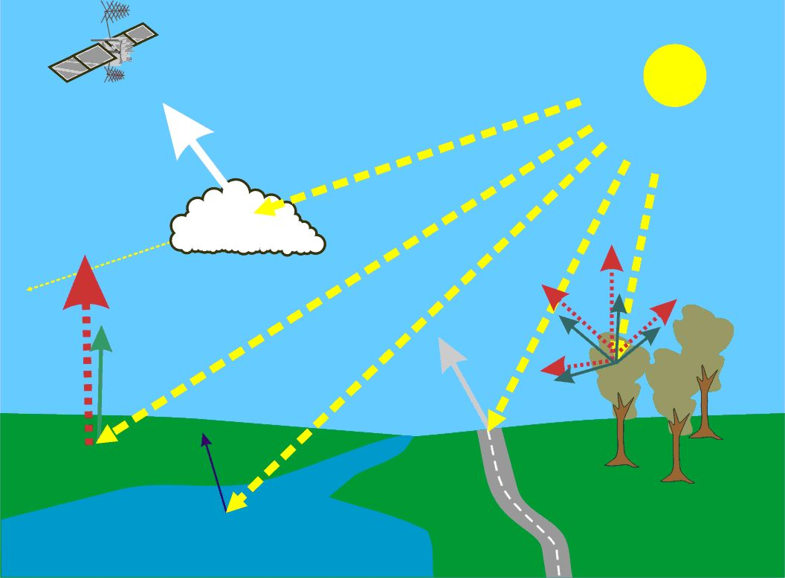
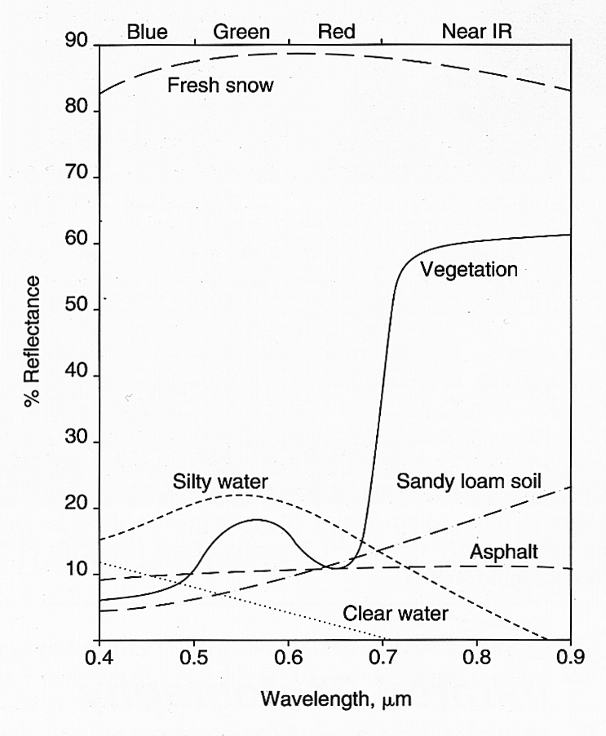
Objects reflect and absorb solar energy differently
Notes:
Describe water and snow sigs.
Why is the grass is green?
Show healthy veg sig
Comment on chlorophyll absorption
Red shoulder at NIR

Slide 22
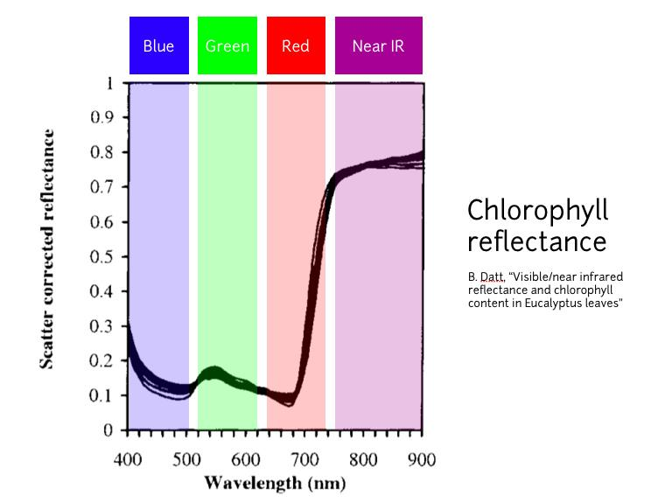
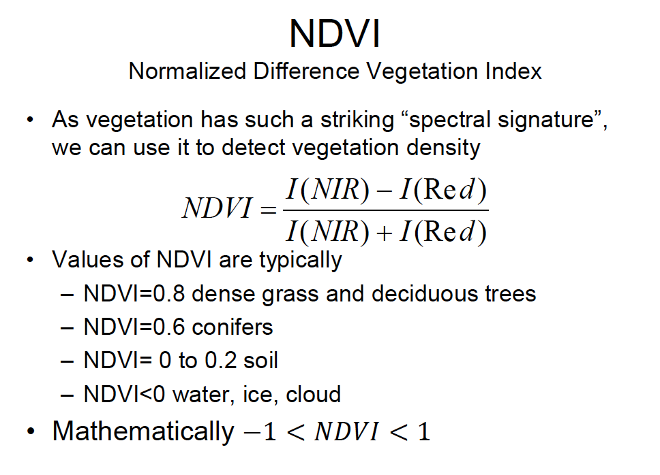
NDVI: Normalized Difference Vegetation Index

Slide 23
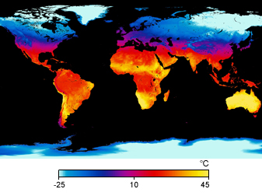
Radiation reaching a satellite
Reflected light from the sun (daytime only)
UV, Visible, NIR, Mid-IR
Information about surface properties
Emitted radiation from earth
Mid-IR, Thermal IR, Microwave
Information about the temperature of objects
Surface temperature from MODIS (April 2009)

Slide 24
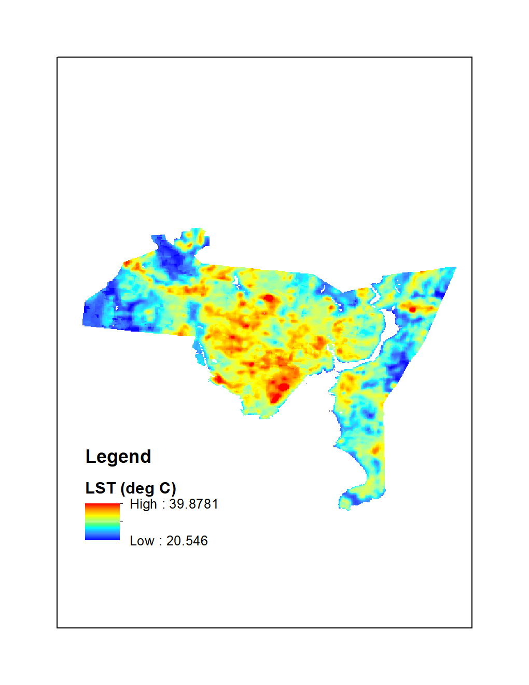
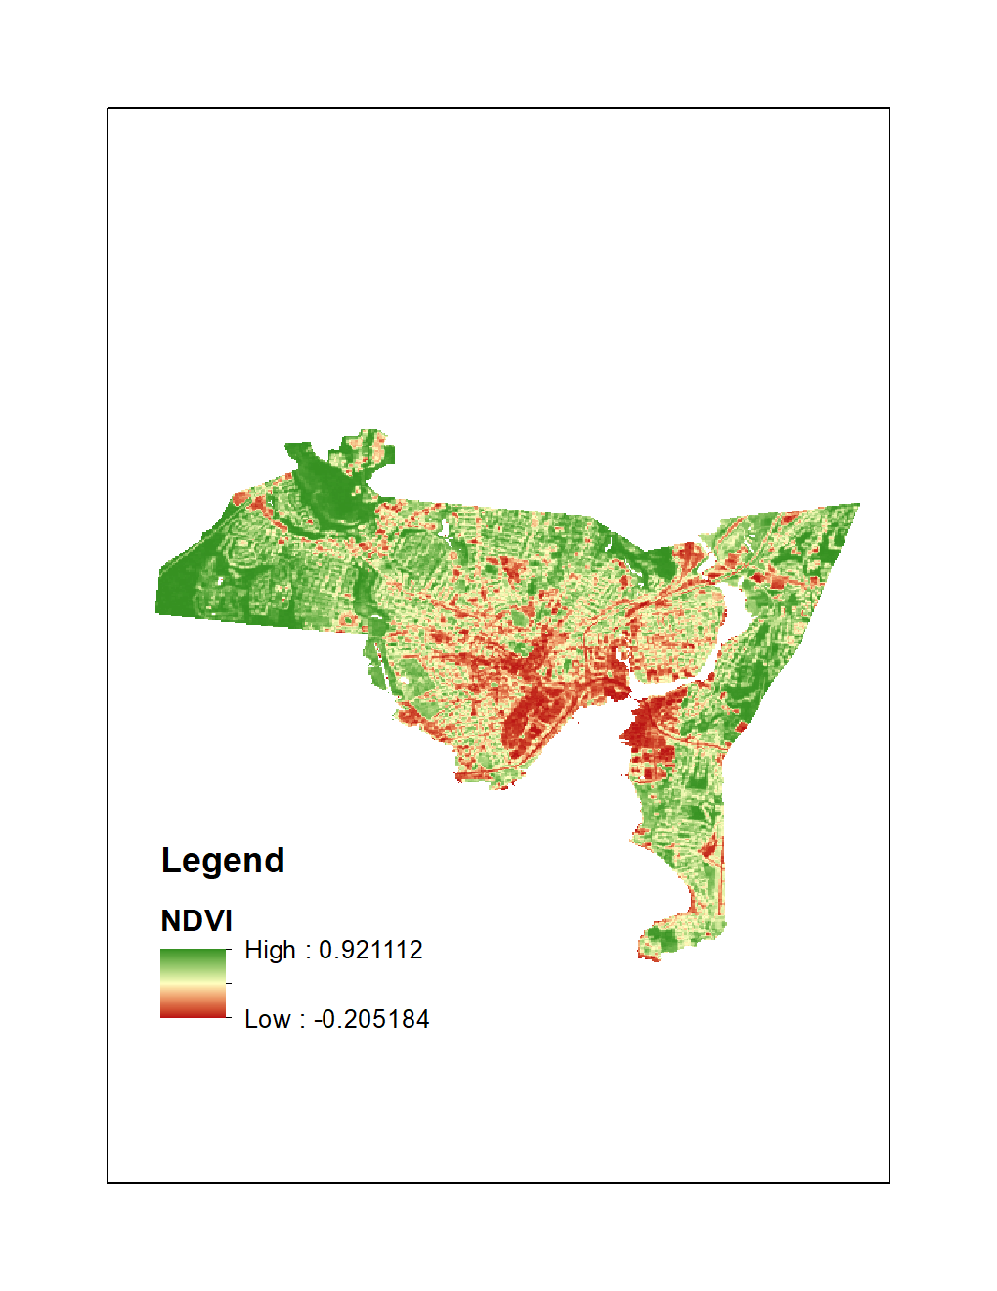
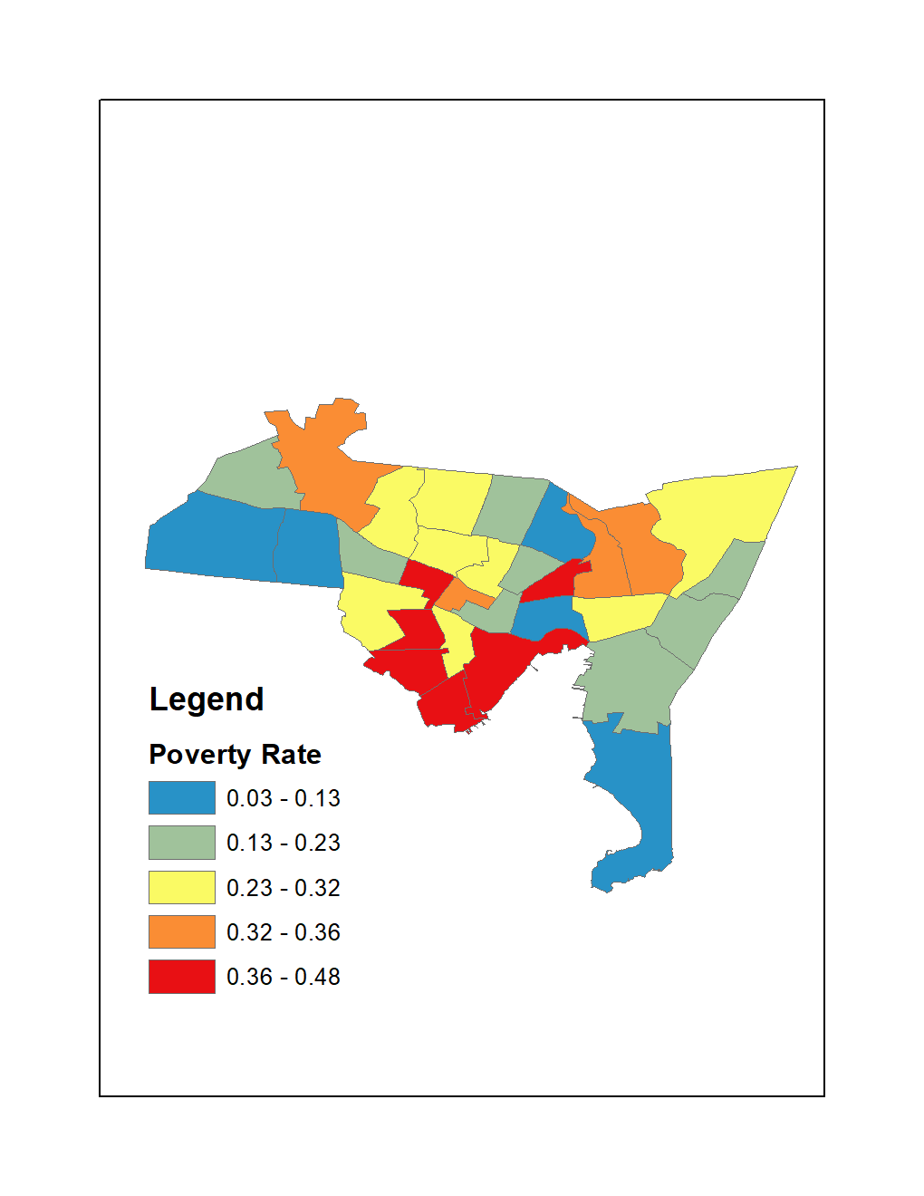
Discussion: New Haven satellite & census maps

Slide 25
R Demo
Overview of workspace
Installing libraries
Running the code

Slide 26
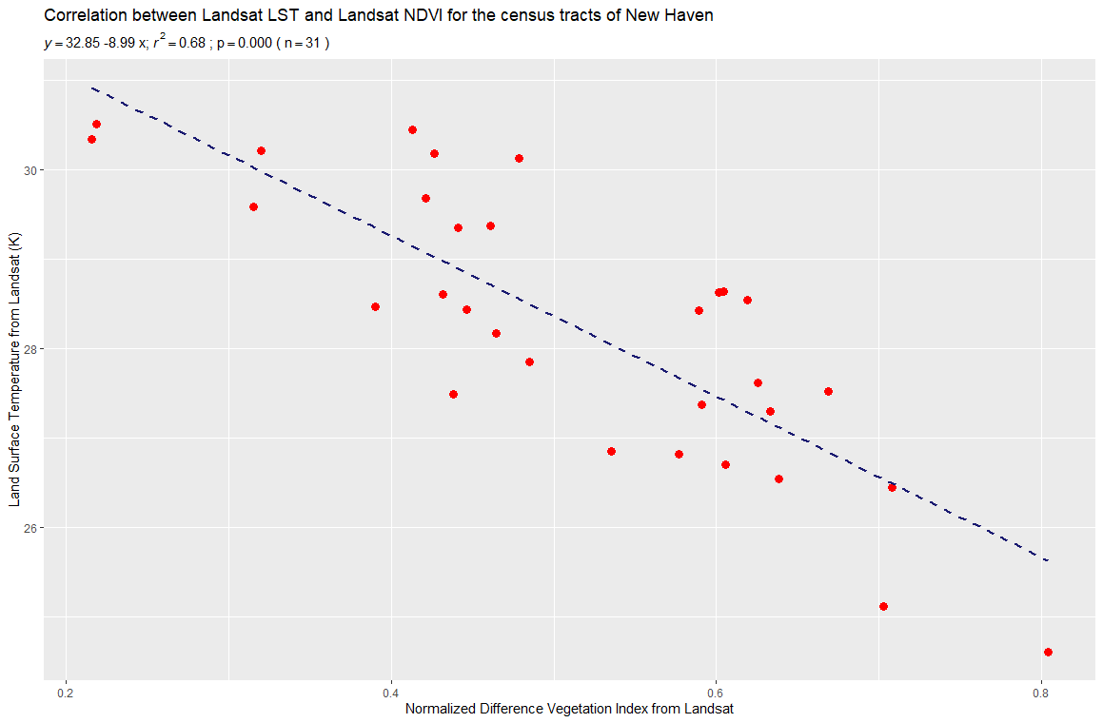
Discussion: NDVI vs. LST

Slide 27
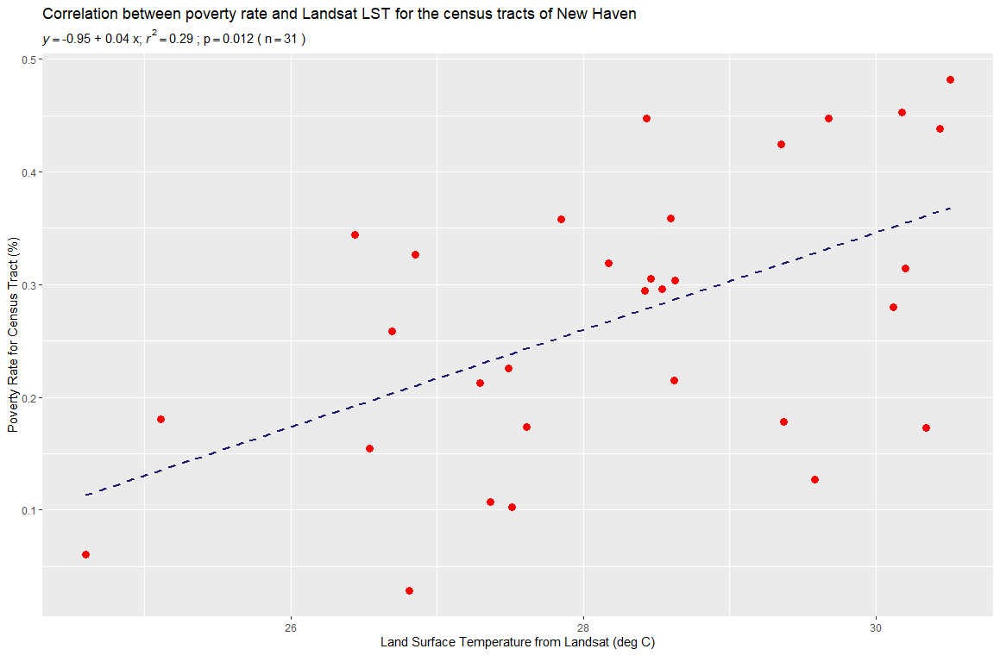
Discussion: LST vs. Poverty Rate

Slide 28
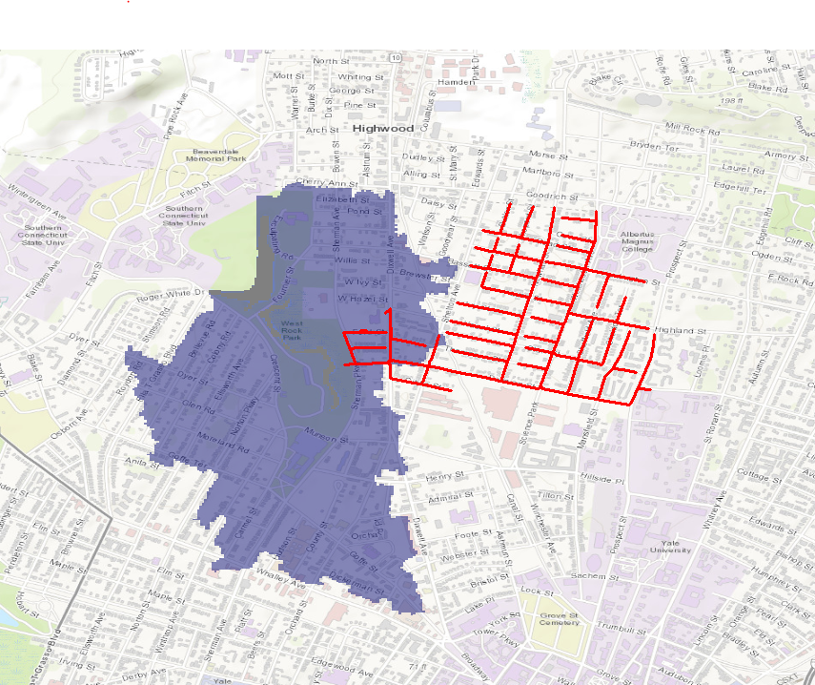
Discussion: New Haven stormwater flow
Sewershed
Watershed

Slide 29
Wrap-up
Thank you!
Review of geospatial resources @ Yale
Questions?
Natalie Schultz
natalie.schultz@yale.edu
TC Chakraborty
tc.chakraborty@yale.edu

